Slide 1
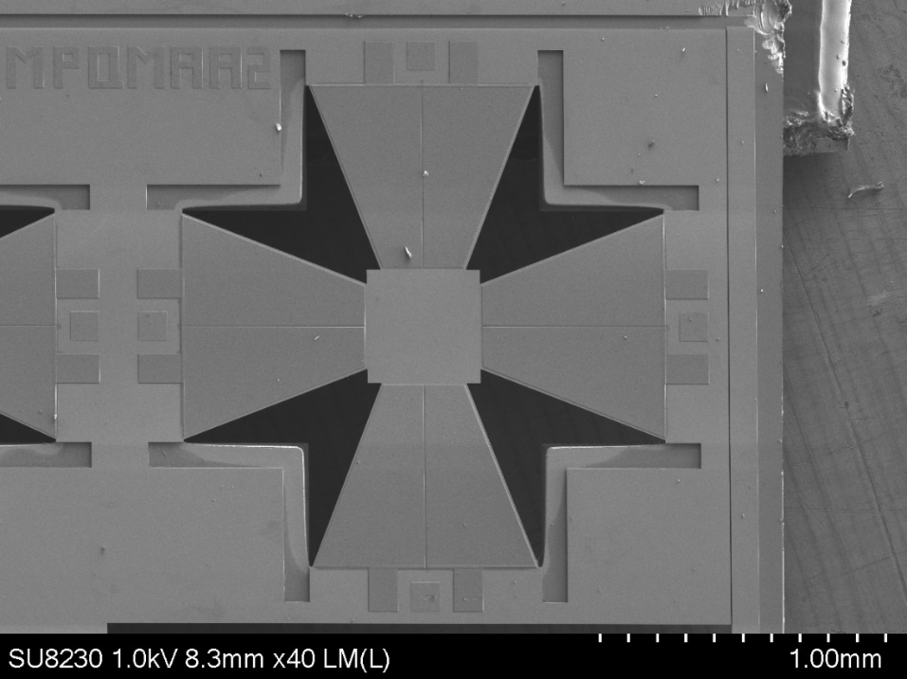
STARaCom poster competition
University Logo
A template for posters presented in the STARaCom poster competition
Author 1, Author 2 and Author 3
University
Contact email
Abstract:
Write here an abstract of the poster
Use of bullet point is encouraged
Changing the colors used in the poster is possible
Please use a consistent color scheme
Background of the poster is better in color rather than white
Problem statement:
We need a unified template for all the posters
Printing posters can be complicated
Poster is in portrait, dimensions 30x40 inch (76,2 by 101,6 inch) this template has the right dimensions
Small text
Content :
Feel free to organize this area as you see fit:
2 column of 37 cm of width
3 columns of 24 cm of width
If your title fits one 1 line you will have a bit more space here
Use bullet points
Use figures
Make sure to align all the boxes
(vertical and horizontal)
Put as few words as possible
Font :
Use Calibri
Title size 115
Names size 36
Small titles size 40
Regular text size36
Conclusion :
We have unified template for all the posters
Thank you for following it
Please make sure to contact us if you have any questions
Acknowledgement :
If you still have space and if it is needed

